Slide 1
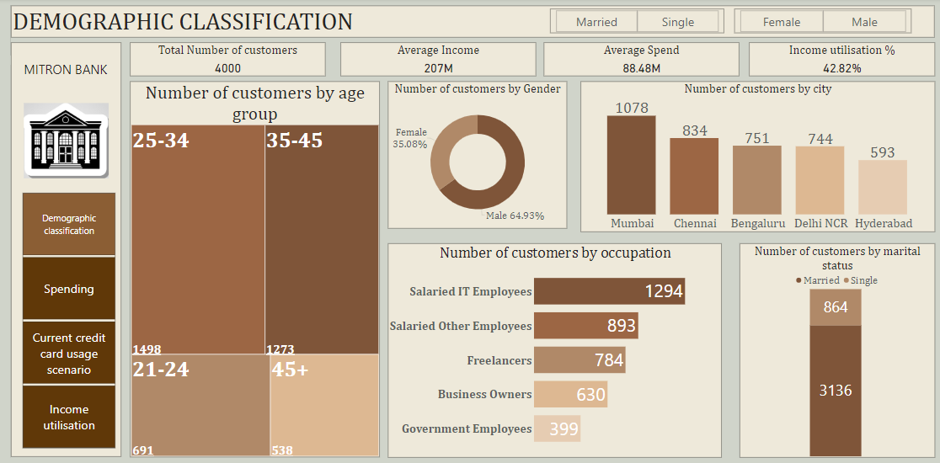

Slide 2
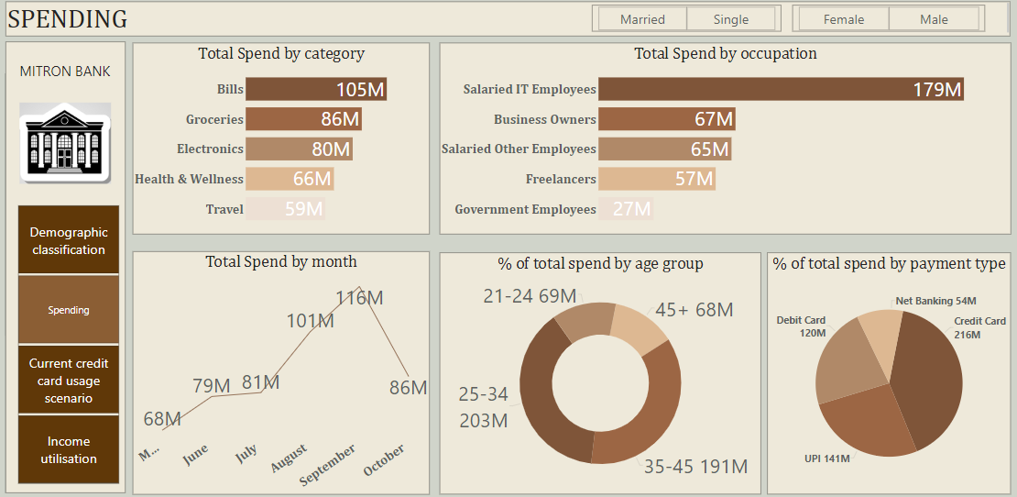

Slide 3
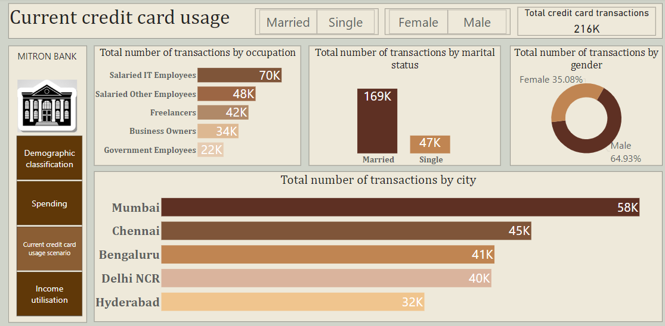

Slide 4
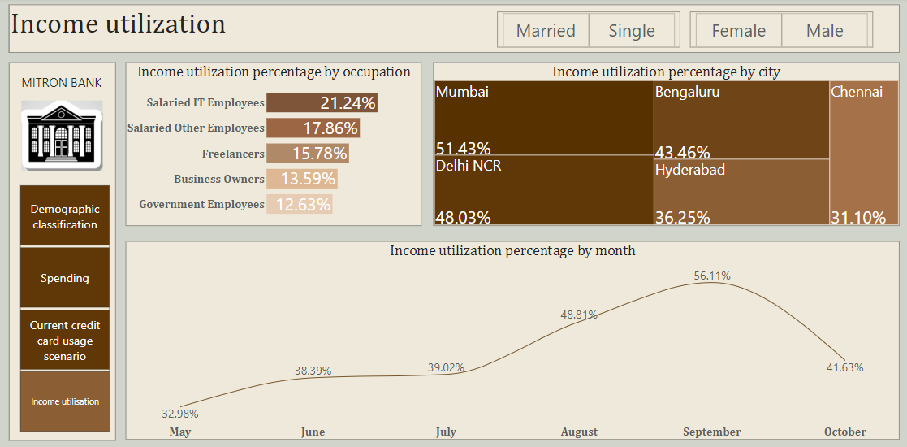

Slide 5
Market Insights
Demographic Insights-
a) Majority of customers are in the age group of 25-34(1498) and 35-45(1273).
b) Nearly 65% of the Customers are Male.
c) Nearly a quarter of our people are IT employees(1294) which is the highest and about
(1/10)^{th} .of people were government employees(399).
Spending Insights-
Top 3 categories where people spend the most money are Bills,Groceries and electronics.
Total transaction value through credit card was 216 M with UPI a distant second at 141 M.
People spent the most in the month of September and the least in the month of May.
Age group 25-34 spent the highest during these period at 203 M followed by age group 35-45 which spent about 191 M.

Slide 6
Current Credit Card Usage-
Total credit card transactions were 216 K. Out of these 216 K,nearly quarter of them happened in the city of Mumbai. In the city of Delhi,Chennai,Bengaluru the number of transactions were in the range of 40K-45K each.
Nearly 65% of Credit Card Transactions were done by Male.
Married people did 169K out of these 216K transactions.
Income Utilization-
Overall income utilization varied from a maximum of 21.24%(Salaried IT Employees) to a minimum of 12.63%(Government Employees).
Except the month of August and September the Income utilization stayed under 40% with the lowest at 32.98% in the month of May. Highest income utilization in the month of September at 56.11%
At the city level city of Mumbai and Delhi had the have income utilization of nearly 50% (Which means that people spend of their income) Chennai had the least income utilization at 31.10 %( Which means that people spend about a third of their income)

Slide 7
Recommendations
Charging lower credit card fees from the second year(First year being free) and providing more time for people to pay for there credit card bills can attract more customers especially people who are in the age group 25-34(who are usually at the start of their career and may not be making lot of money).
Company should create social media accounts on all major platforms and post engaging content(Memes etc)which would attract more users. Place ads on websites and search engines that are popular in India. Company should also invest in SEO so mitron bank websites pop up when people search for ‘Credit Cards’. Placing billboards across major cities of India.
Company should be thinking of mobile apps where the customer can access the various features of a card(Paying credit card bills,blocking of credit card in case it is lost,Contacting customer service and many other things)and can even make a payment using the app through the NFC technology. Enabling UPI services in mobile apps so that people can link their credit card to UPI and make payment through it.

Slide 8
d) We can see that the Bills,Groceries and electronics are the top three categories where the people spend most of the money ,so we can introduce attractive reward programs such as cashback,reward points when paying for bills,groceries, electronics which can be used later.
e) People working as IT employees are found to have highest income utilisation and they also spend a lot so tying up with the IT companies in India and providing incentives to the company so that they insist their employees in opening their salary account with the Mitron Bank which would increase their chances of getting a Credit Card.
f) Opening more bank branches in the city of Mumbai,Delhi so that people can have easier access to the bank where they can open credit cards.

